Slide 1
Applied Arduino Programming for neurophysiology
(supplementary materials)
Mike Sintsov
Head of Man-Machine Interfaces
at Motorica LLC

Slide 2
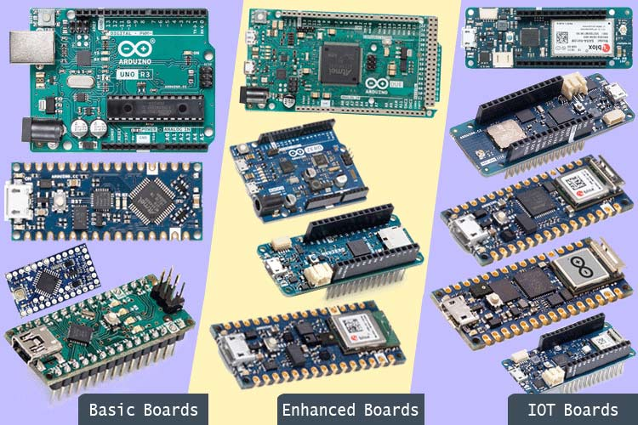
What is Arduino?
Company
Platform (both, hardware + software)
Workstyle … not a good one (toxic DIY)

Slide 3
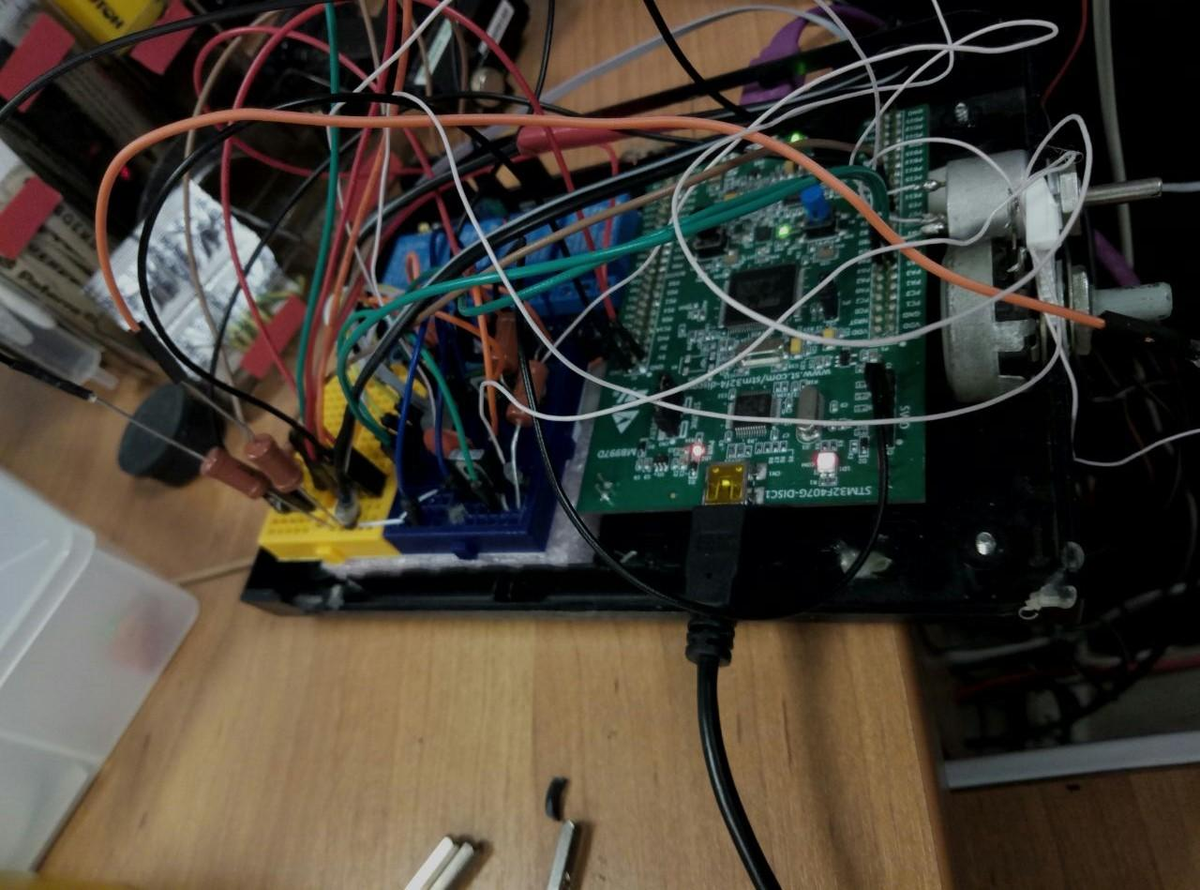

Toxic DIY

Slide 4
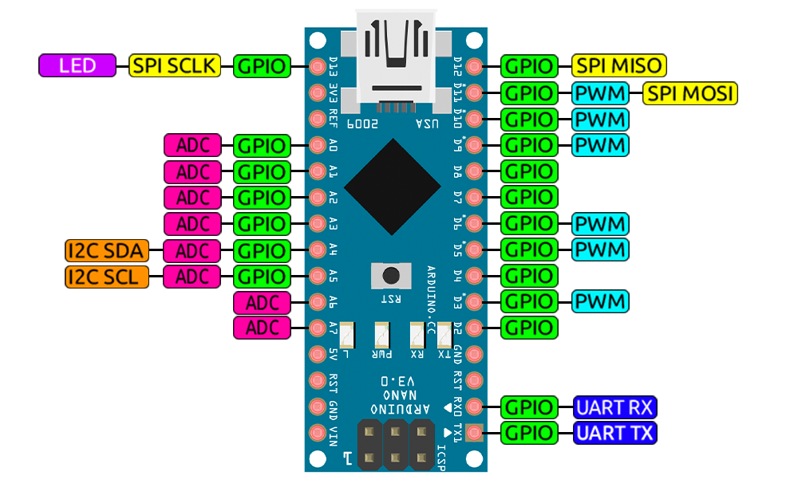
What should we use Arduino for?
PC-Hardware communication
Collecting data
Synchronizing with external hardware (PC or amplifier)
Producing stimuli
Tactile
Visual
Audial
Install EasyEDA for schematic design
We will work with Arduino Nano V3

Slide 5
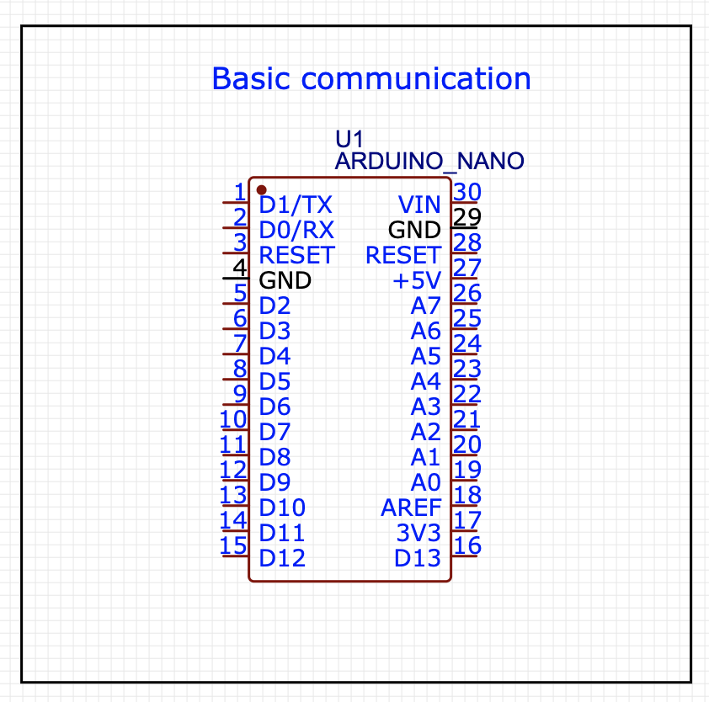
PC-Hardware communication
Download and install Arduino Studio
(Win users) download ch340 drivers (instructions)
Connect to PC
Flash blink example
Mind Old/New bootloader
Flash serial example
Hint: fast ascii-dec convertor
UART is not instantaneous!!!
See comments here
Try echo loop

Slide 6
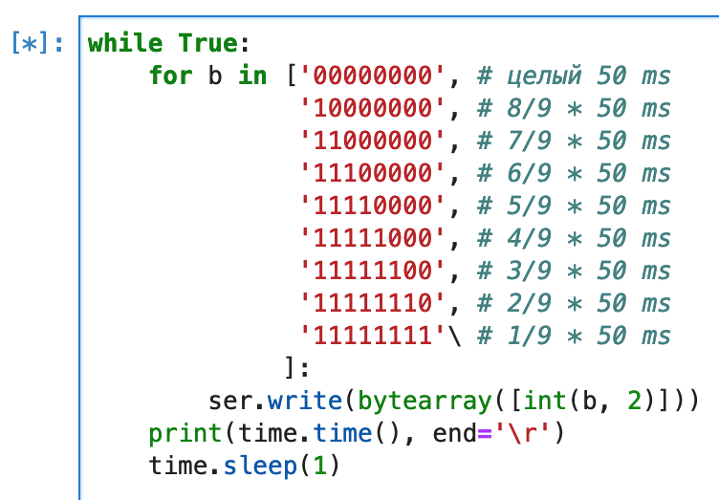
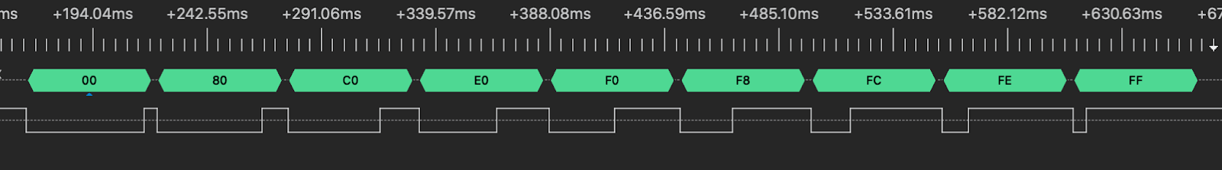
What does Boudrate of `Serial` mean?
Boudrate = bits/second
Serial = UART, universal asynchronous receiver and transmitter
UART pack of Arudino = 10 bit
1 start — always 0
8 payload — 1 or 0
1 stop — always 1
E.g. Baudrate = 180 means max 0-s in a row = 50 ms

Slide 7
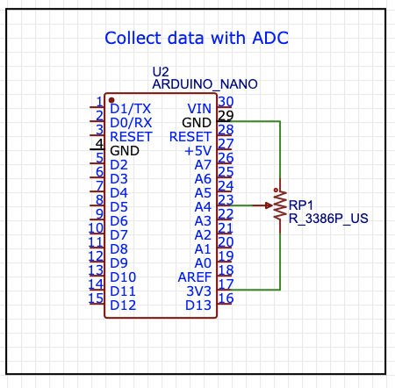
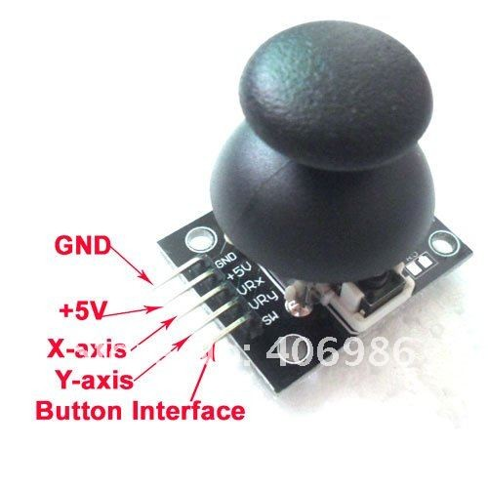
Collect data with analog to digital converter (ADC)
Learn how to work with Serial Monitor and Serial Plotter
Try 3.3v instead of 5v
Try plotting in Jupyter
Can be used to track fingers
Or joystick input

Slide 8
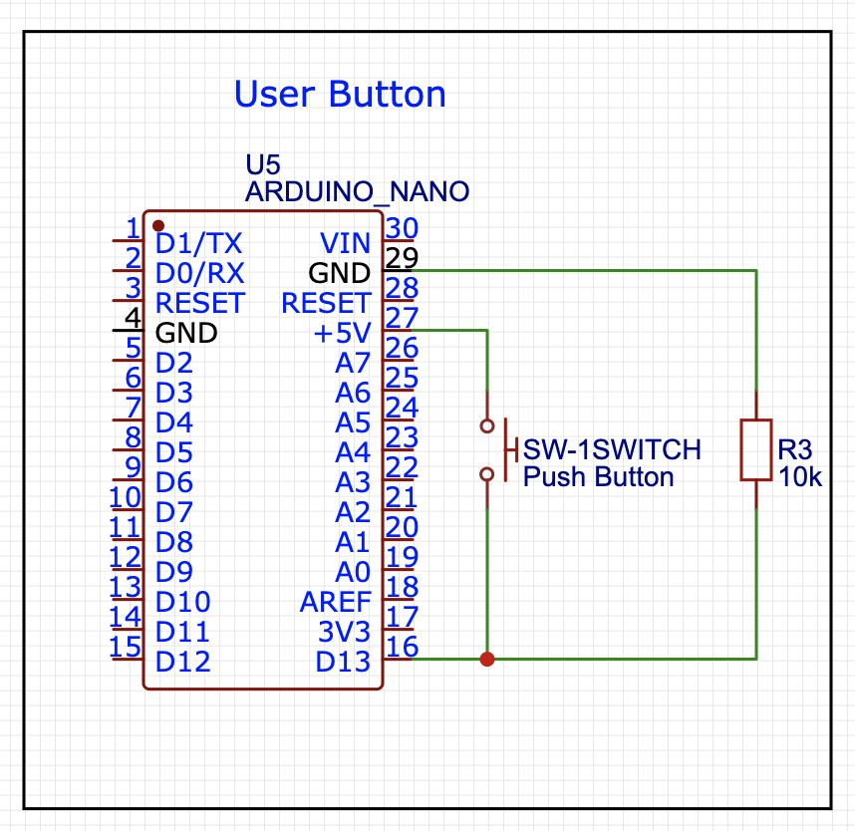
User Button
Mind pull-down (or pull-up) resistor
Mind jittering effects, debouncing (software, or hardware)

Slide 9
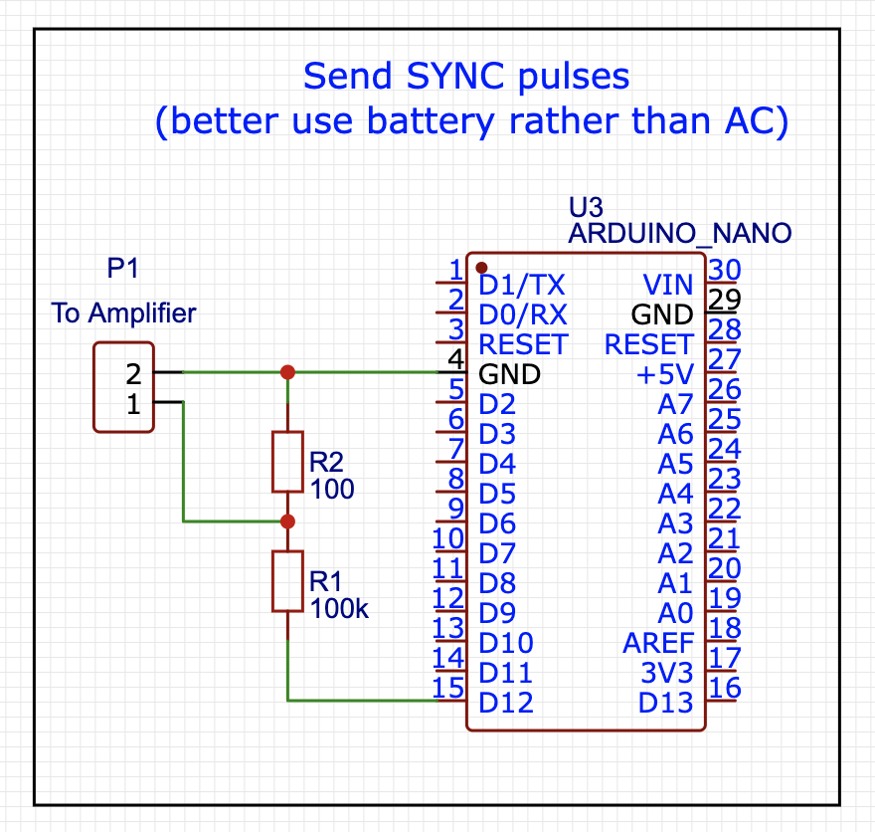
Send Synchropulses to Hardware
!!!!!!!!USE BATTERIES AND POWERBANKS!!!!!!!!!
Or transmit signals with optical coupling
(For convenience – we will use D2 GPIO pin)

Slide 10
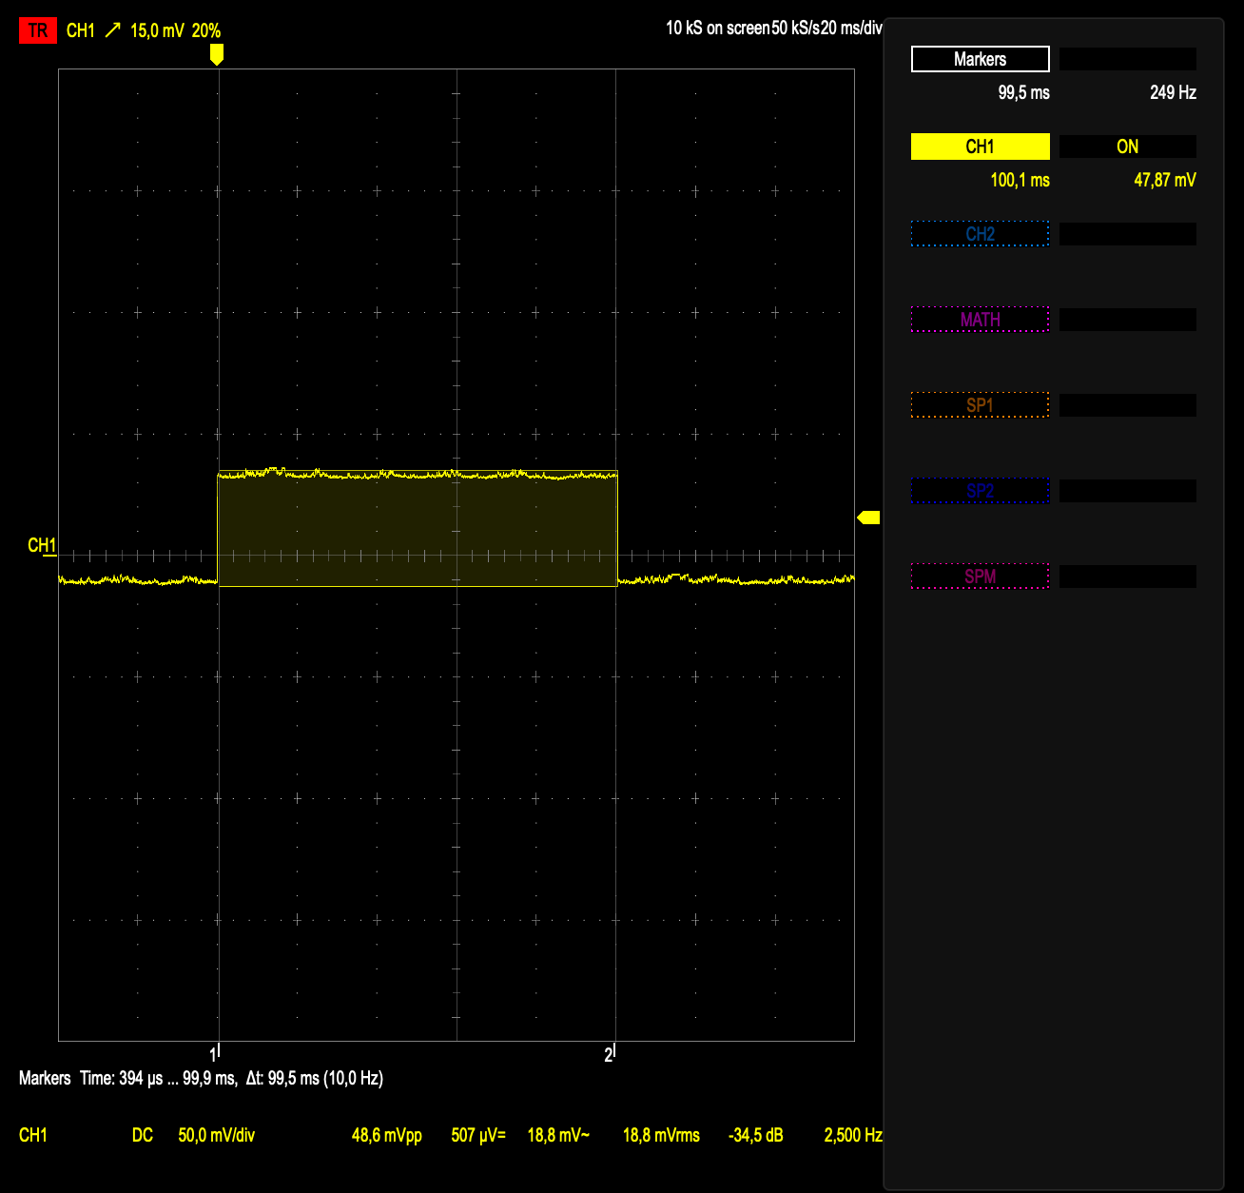
Sync Pulses
Let’s fit it to 0..50mV

Slide 11
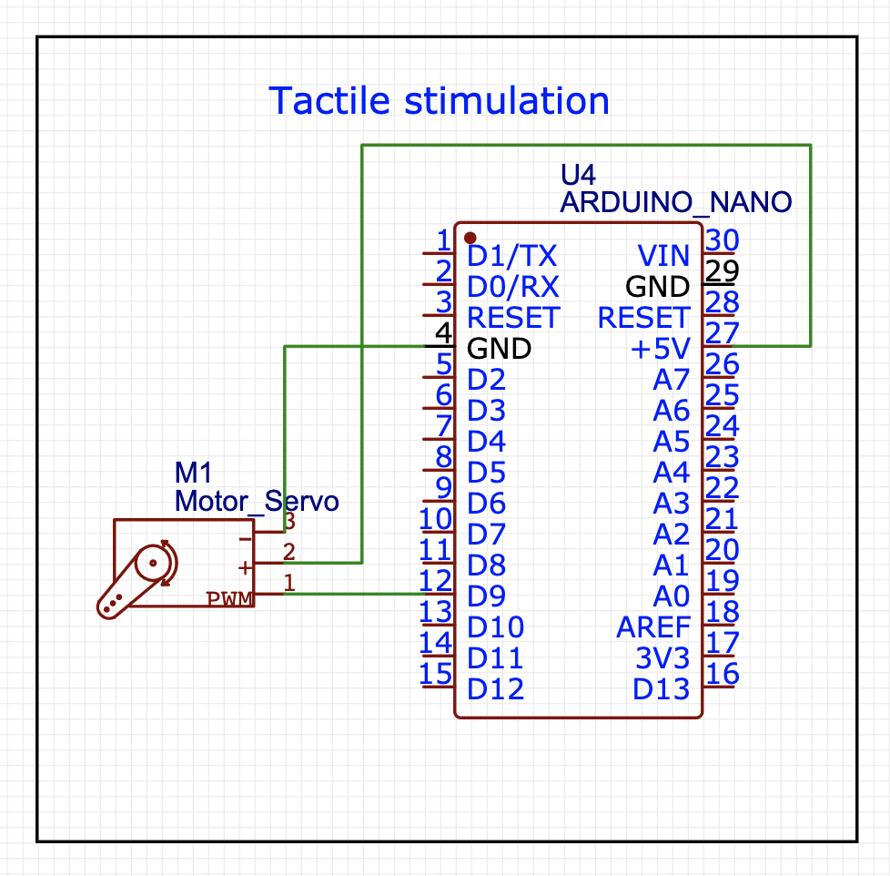
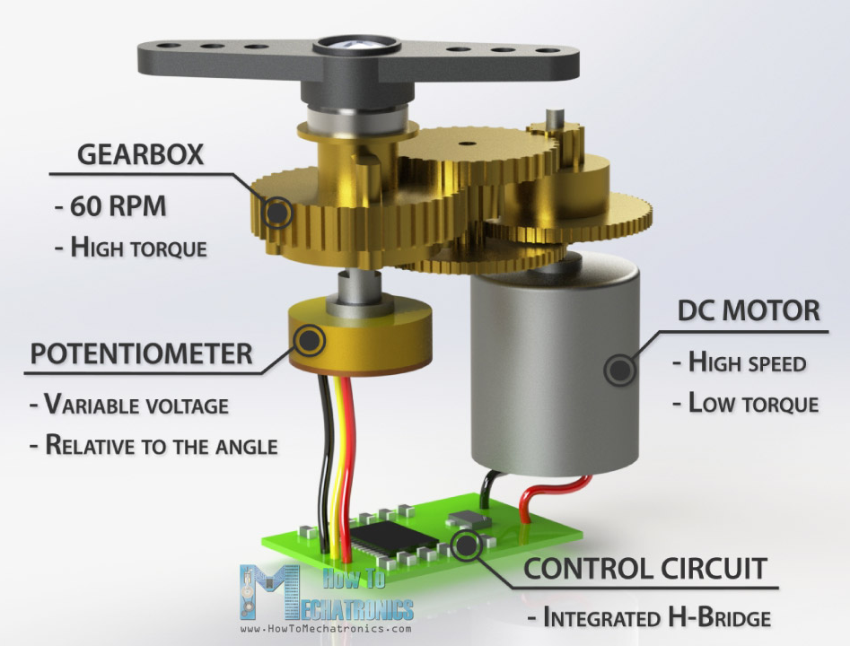
Somatosensory stimulation
More info
https://www.electronics-lab.com/project/using-sg90-servo-motor-arduino/

Slide 12
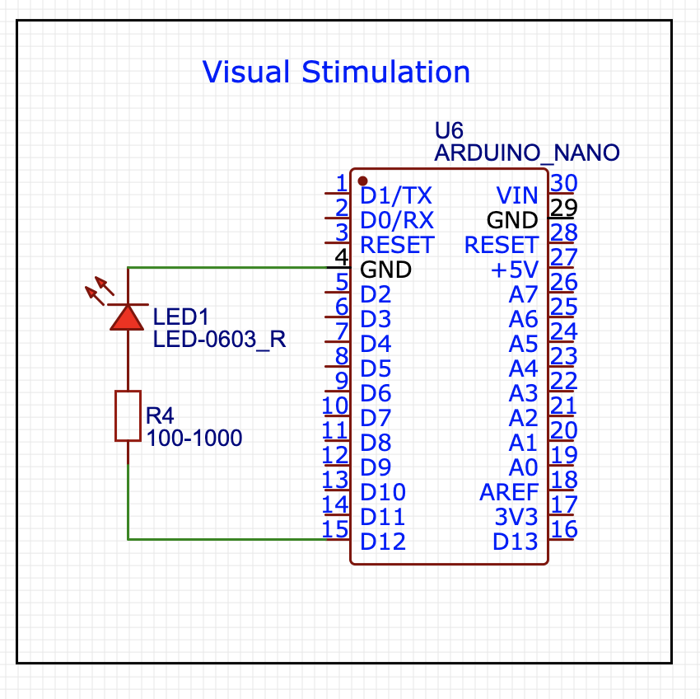
Visual stimulation
It is actually a blink test sketch

Slide 13
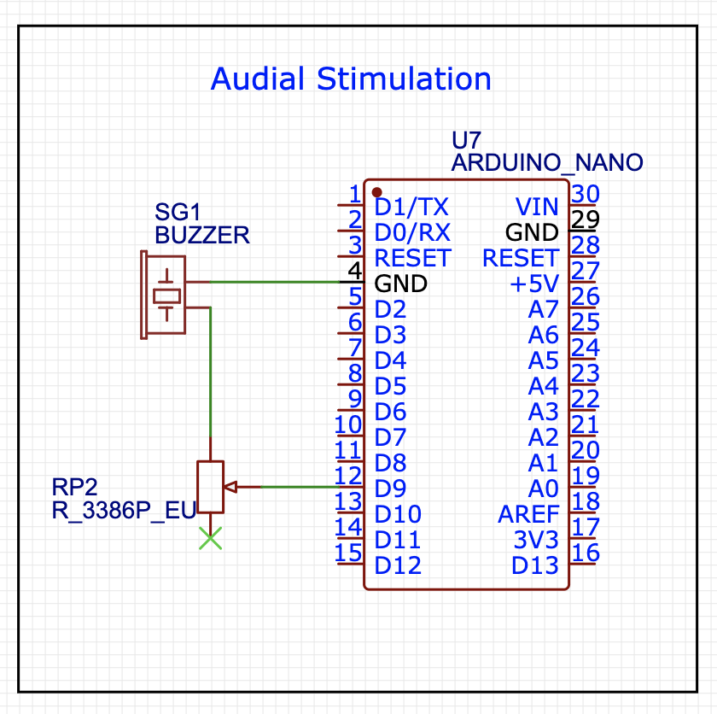
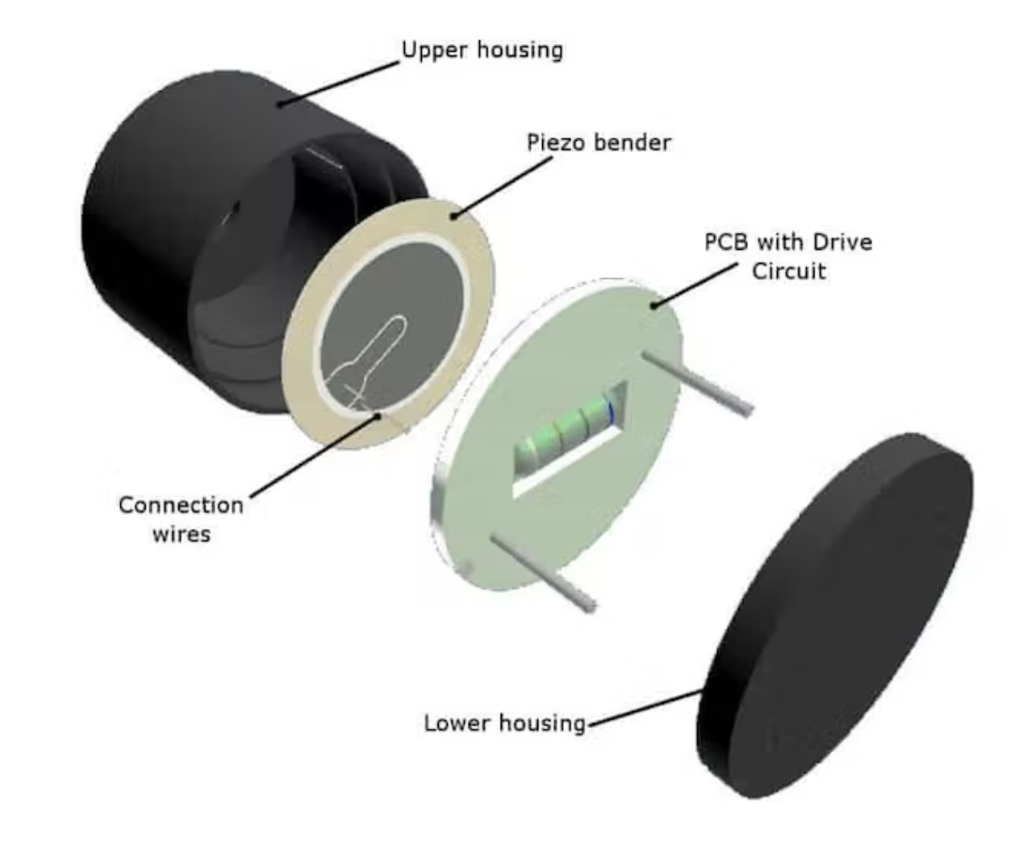
Audial Stimulation
Be gentle — use resistor to decrease buzzer volume
We will use the same script as blink!

Slide 14
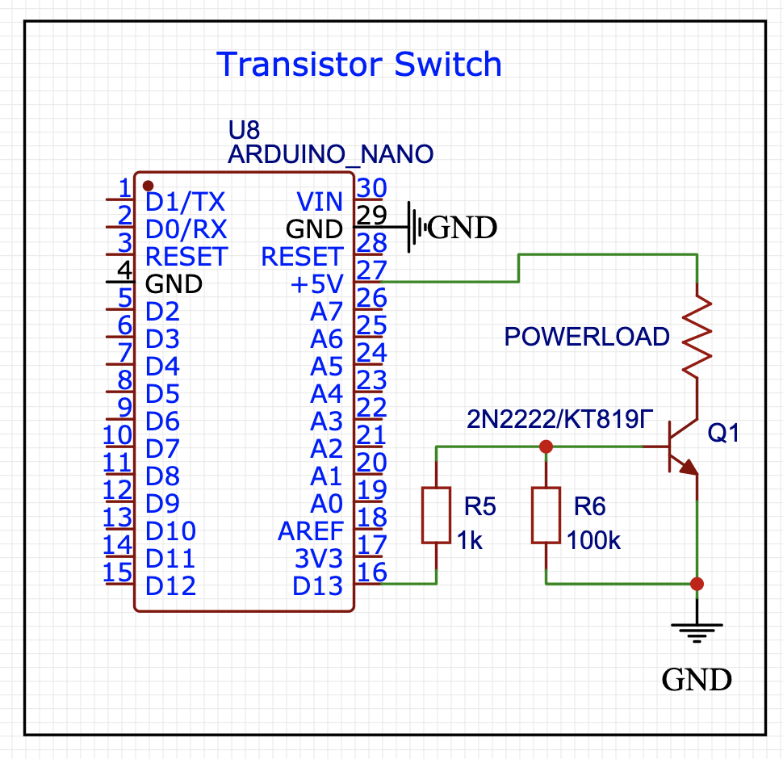
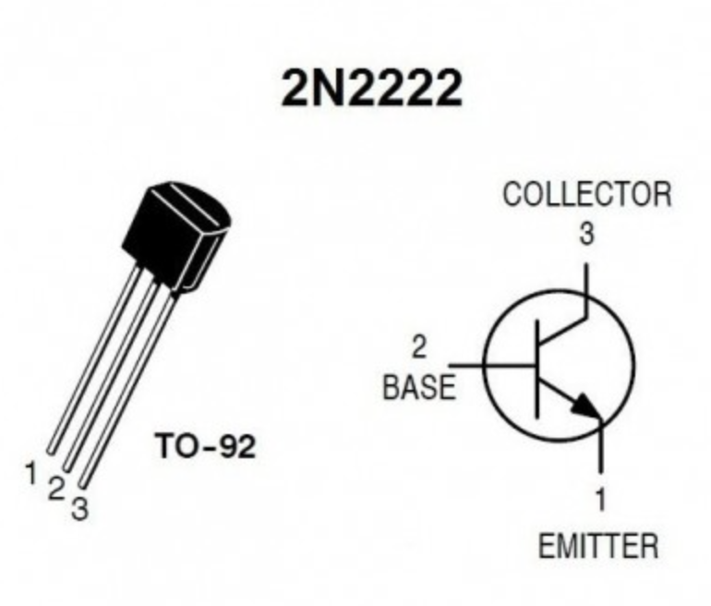
Transistor switch
Switches high power load

Slide 15
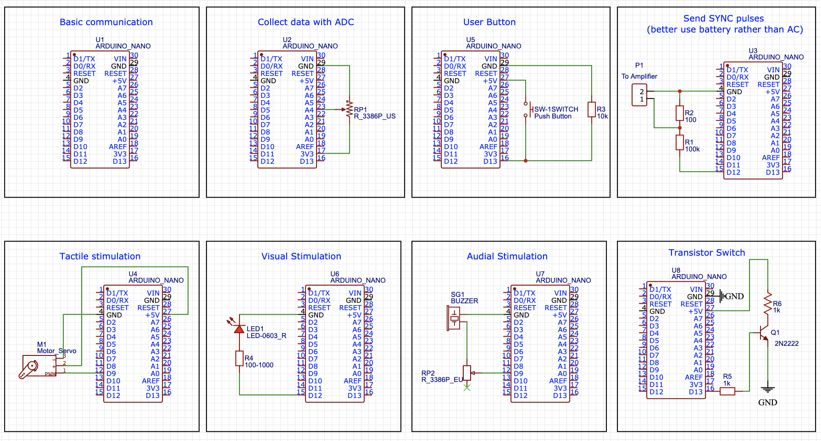
Don’t be afraid of trials and errors

Slide 16
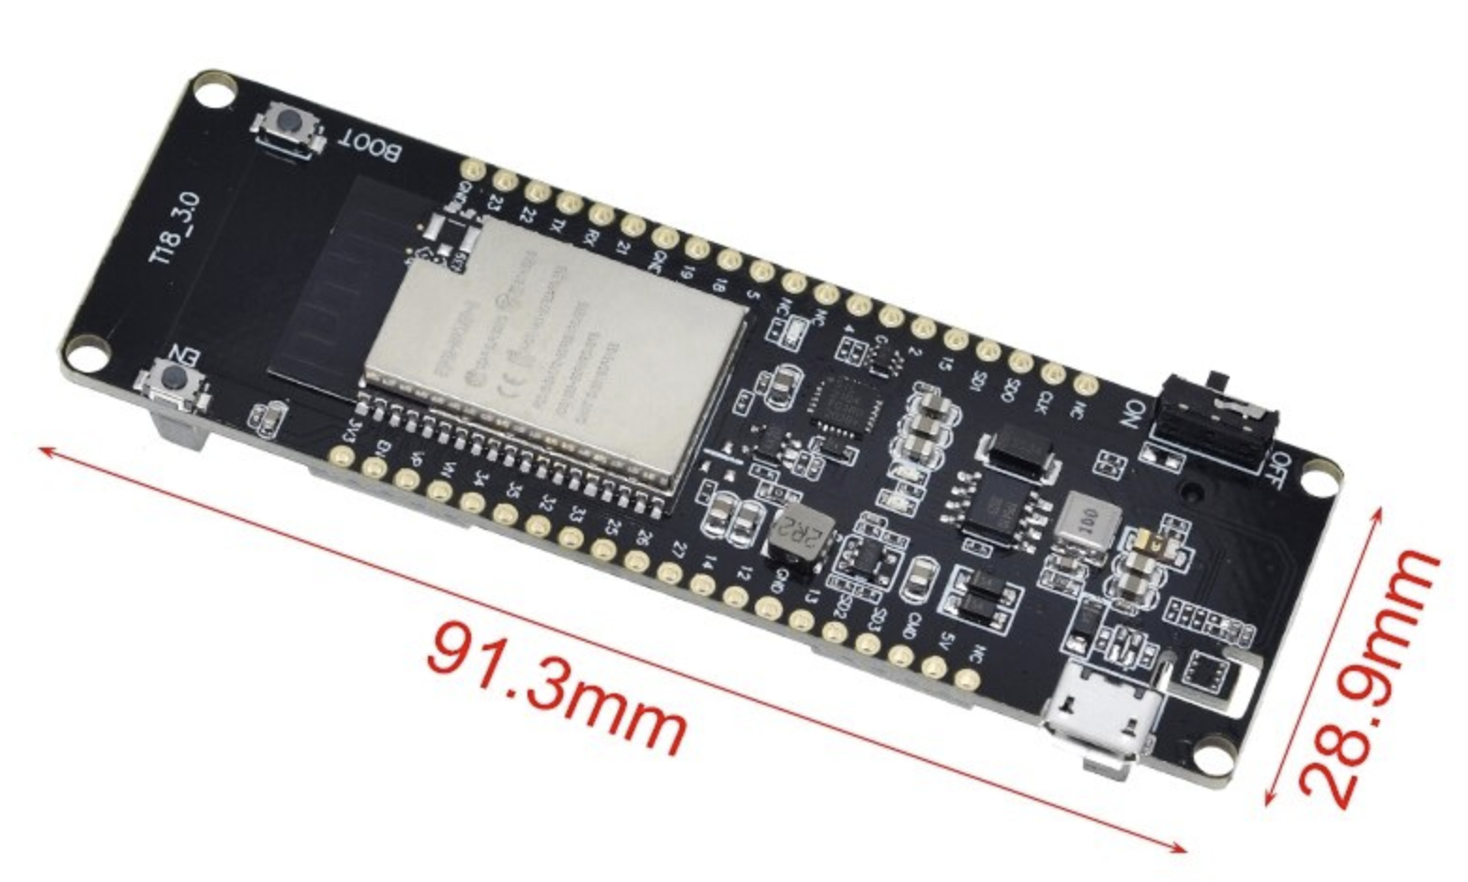
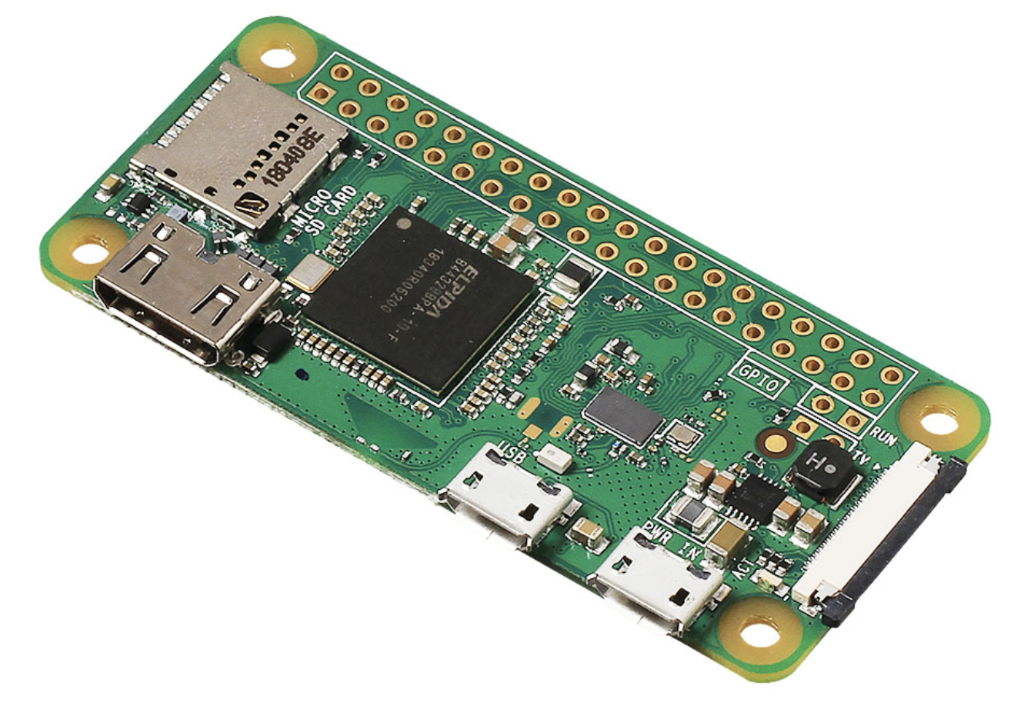
Additional information
Learn to build Arduino-Arduino communication: https://iot-guider.com/arduino/serial-communication-between-two-arduino-boards/
Also look at wireless boards of ESP32-Wrover-xx (BT works as simple as Serial!) and Raspberry Pi 3, 4, Zero (W) = wireless linux with gpio

